Slide 1

Digital Electronics (EC-107)
Lecture 1 (Overview)

Slide 2
AIM
To give a first course in digital electronics providing you with both the knowledge and skills required to design simple digital circuits and preparing you for a second, more advanced, course Digital System Design.

Slide 3
Objectives
To impart to you a formalism of logic enabling you to analyze logical processes
To enable you to implement simple logical operations using combinational logic circuits
To enable you to understand common forms of number representation in digital electronic circuits and to be able to convert between different representations
To enable you to understand the logical operation of simple arithmetic and other MSI circuits (Medium Scale Integrated Circuits)

Slide 4
To impart to you the concepts of sequential circuits enabling you to analyze sequential systems in terms of state machines
To enable you to implement synchronous state machines using flip-flops

Slide 5
Analog Signals
Time-varying signals
Take any value across a continuous range of voltage, current or whatever metric
Analog electronics represents information as a continuously variable voltage
v (t)= A sin (wt+ Φ)
has information A, w, Φ

Slide 6

Eg. Analog Signal

Slide 7
Digital Signals
Digital electronics represents information as a set finite values.
or
Digital electronics represents information as a sequence of discrete voltage levels
if there are 2 levels we call this binary information
here the information is the order and duration of the voltage levels

Slide 8
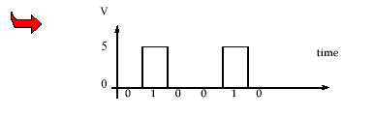
Digital Signal

Slide 9
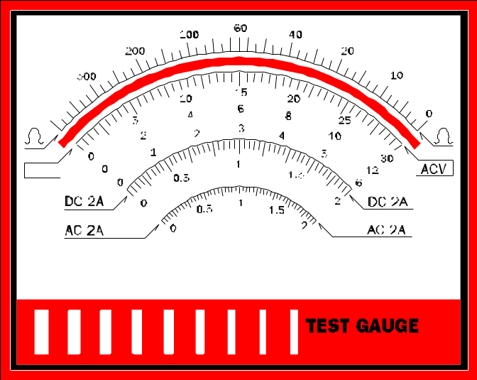
Analog versus Digital
Analog Voltage meter
Digital Voltage meter
103.5
About 100

Slide 10
Analog offers Continuous Spectrum
Digital offer distinct Steps
Analog Spectrum
Digital Spectrum

Slide 11



Analog has Ambiguity
Digital has only one interpretation
Analog Clock
Digital Clock
1:56 pm
1:56
About 2:00
1:56
1:50

Slide 12
Why Digital?
Reproducibility of results
Ease of design: digital design is logical (logical design)
Flexibility and Functionality
Programmability
Fast
Economy

Slide 14
Electronic Implementation of Logic
It is common to use positive logic implementation:
TRUE (1) 5 Volts
FALSE (0) 0 Volts
if we measure the voltage at a point in a circuit, we can say whether the logical value at that point is TRUE or FALSE.
it is common to use Logic 1 for TRUE and Logic 0 for FALSE.

